Slide 1
18ECO134T – Sensors and Transducers
Unit III : Session 9 : SLO 1
SRM Institute of Science and Technology
Notes:
Pl use Font Family : Arial Narrow
To enhance the teacher presentations and the overall comprehension of students, it allows to present their lessons in a more dynamic and effective way. Set a Learning Objective:
1. Write an Outline for Key Ideas
2. Give the Presentation About Education a "Why"
3. Share Techniques and Tips for the Topic
4. Teach With Visualizations
5. Use Animations Carefully

Slide 2
Scintillation Detector

Slide 3
Scintillation Detectors
Certain single crystals of organic or inorganic materials, activated glasses/liquids or plastic fluors have the property that when they receive high energy radiation, they produce very short duration light pulses or flashes called “Scintillations”.
These materials are known as Scintillators.

Slide 4
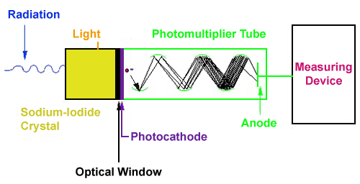
Scintillation Detector

Slide 5
Scintillation Detectors
Certain single crystals of organic or inorganic materials, activated glasses/liquids or plastic fluors have the property that when they receive high energy radiation, they produce very short duration light pulses or flashes called “Scintillations”.
These materials are known as Scintillators.

Slide 6
Scintillation Detector

Slide 7
Scintillation Detectors
The basic principle behind this instrument is the use of a special material which glows or "scintillates" when radiation interacts with it.
The most common type of material is a type of salt called sodium-iodide. The light produced from the scintillation process is reflected through a clear window where it interacts with device called a photomultiplier tube.
The first part of the photomultiplier tube is made of another special material called a photocathode.
The photocathode produces electrons when light strikes its surface.

Slide 8
Scintillation Detectors
These electrons are then pulled towards a series of plates called dynodes through the application of a positive high voltage.
When electrons from the photocathode hit the first dynode, several electrons are produced for each initial electron hitting its surface.
This "bunch" of electrons is then pulled towards the next dynode, where more electron "multiplication" occurs.
The sequence continues until the last dynode is reached, where the electron pulse is now millions of times larger then it was at the beginning of the tube.

